Slide 1
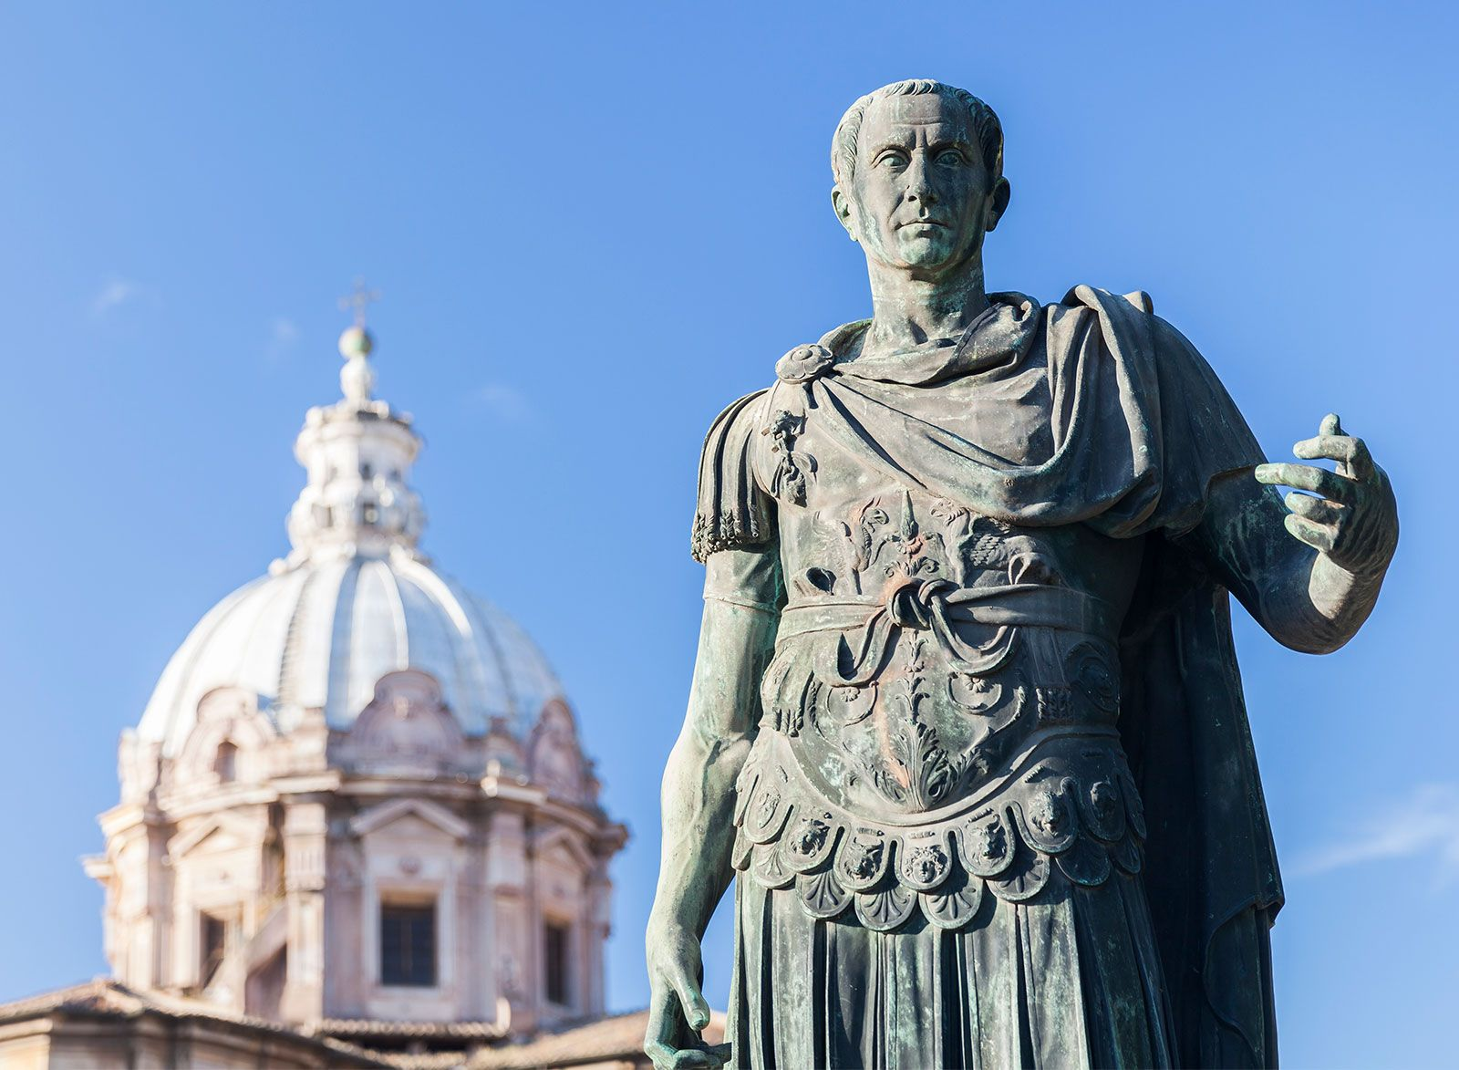
Revision 1
Revise key ideas, events, people – Julius Caesar
Week 8 Lesson 1
Ms Barrie

Slide 2
Revision Activity 1 - Content
Revise ALL key content for Julius Caesar
Question suggestions:
The First Triumvirate
Caesar’s Aims and Motivations
Long Term/Short Term Impacts
Leadership methods
Key Events
Impact of Death
Dictator or great leader?

Slide 3
Julius Caesar

